Slide 1
Docker Engine & Images
Sameer Zulfi

Slide 2
Starting a new container
docker container run –name container1 –it alpine:latest
The above command will be typed inside CLI.
What happens next ???
The docker client converts them into API and POSTs them to correct API endpoint.
API -> Daemon. Once Daemon receives the command to create new container, it makes a call to containerd.
Remember, Containerd cannot actually create containers. It uses runc to do that.
Job of containerd is nothing but to supply the right image to runc to start the container

Slide 3
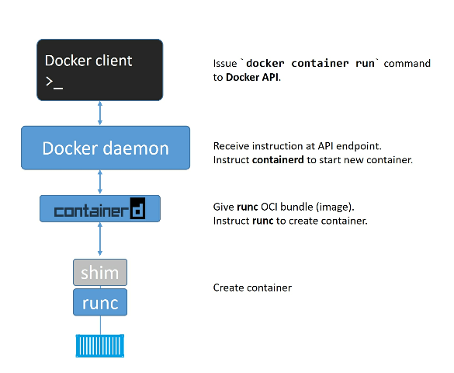
What is the Process ??

Slide 4
Images
Image = files + metadata (author, env., variables etc., )
Images are like Templates
A Docker image is like stopped container
You start by pulling images from an image registry
Most Popular registry is DockerHub
Images are made up of multiple layers

Slide 5
Images and Containers friendship
Once you started a container from an image, the two become dependent on each other and you cannot delete the image until the last container using it has been stopped or destroyed.
docker image rm <imagename>
Images are very small.
For ex: Alpine is only 4MB
Official Ubuntu is only 110MB

Slide 6
Pulling Images
Local image repository location is /var/lib/docker
Docker image ls
The process of getting images onto a docker host is called Pulling.
Docker image pull Ubuntu:latest
Docker image pull alpine:latest
Docker image ls

Slide 7
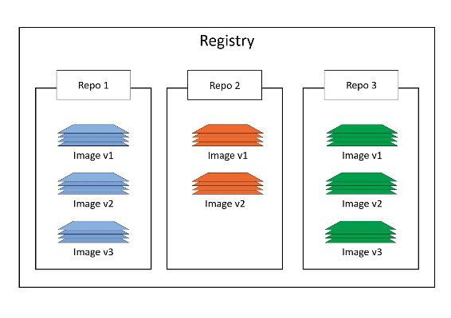
Image Registries
It contains multiple image repos

Slide 8
Official and Unofficial Repos
Official Examples:
https://hub.docker.com/_/nginx
https://hub.docker.com/_/httpd
https://hub.docker.com/_/busybox
Un-official Examples:
https://hub.docker.com/r/nigelpoulton/tu-demo

Slide 9
Image Naming and tagging
Docker image pull <repository>:<tag>
Docker image pull alpine:latest
Docker image pull Ubuntu:latest
Docker image pull mongo:3.3.11
Docker image pull redis:latest
Docker image pull alpine
docker pull awssameerzulfi/prodapp:v1

Slide 10
Filtering
Docker image ls –filter dangling=false
docker image ls --filter=reference="*:latest“
docker image ls --format "{{.Size}}“
docker image ls --format "{{.Repository}}: {{.Tag}}: {{.Size}}"

Slide 11
Searching Dockerhub from CLI
Docker search httpd
Docker search nginx
Docker search alpine
Docker search alpine –filter “is-official=true”
By default docker will only display 25 line. You can use –limit to limit it to 100.

Slide 12
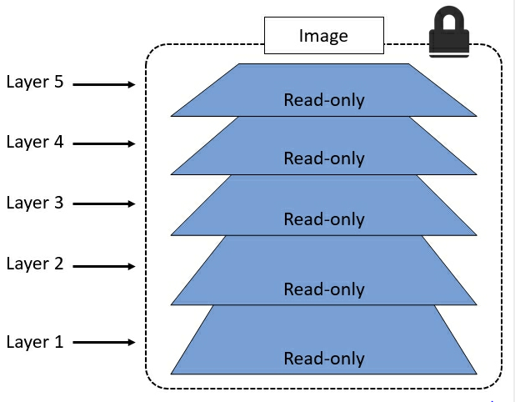
Images and Layers
Image is nothing but consists of many layers.

Slide 13
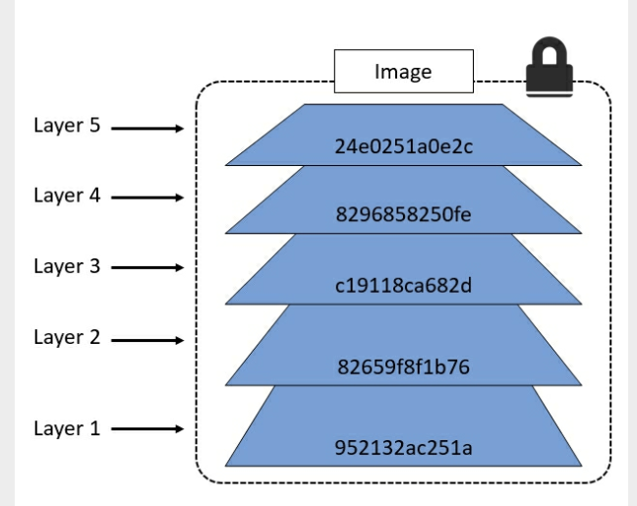
Docker image pull Ubuntu:latest
Now see the lines ending “Pull Complete”
Try this command:
Docker image inspect
Ubuntu:latest

Slide 14
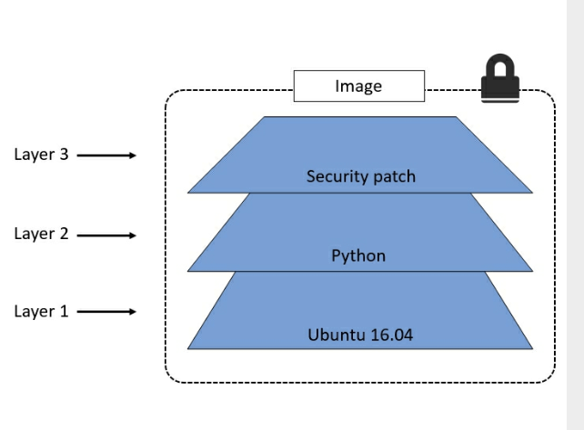
ENV, EXPOSE, CMD, ENTRYPOINT will never create any layers. It just adds meta-data.
All docker images starts with base layers.

Slide 15
Example for a Java webapp
Each of the following items will correspond to one layer:
CentOS base layer
Packages and configuration files added by our local IT
JRE
Tomcat
Our application's dependencies
Our application code and assets
Our application configuration

Slide 16
Deleting Images
Docker image rmi <imageid>
Shortcut to delete all the images:
Docker image rm $(docker image ls -q) -f

Slide 17
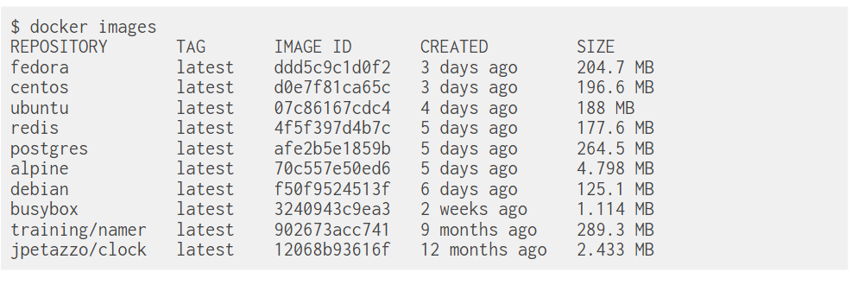
Can we download all these images

